Slide 1
Embry-Riddle Aeronautical University
ASCEND! - Solar Cells
By: Mary Begay
Jessica Avitia
NASA Space Grant – ASCEND!
Mentors: Dr. Ronald Madler, Jack Crabtree
April 17, 2010

Slide 2
Overview
Objective for using Solar Cells
Type of Solar Cell
Mounting
Flight Results
Future Goals
Acknowledgements

Slide 3
Objective
For this flight we did not intend to use the cells as a source of power
Research purposes - further our knowledge of solar cells
Collect voltage data from flight
Possible energy source for the payload components for future flights.

Slide 4
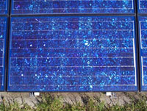
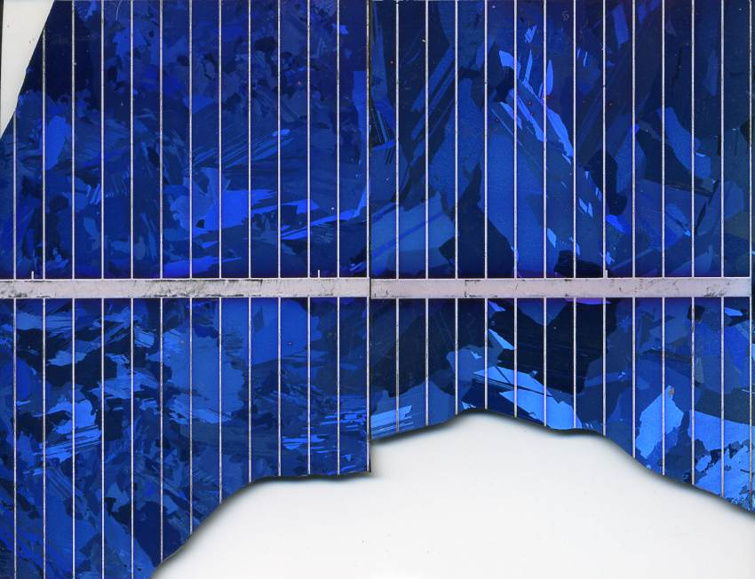
Types of Solar Cells
Polycrystalline solar cells
Brittle
Would not last throughout our flight

Slide 5
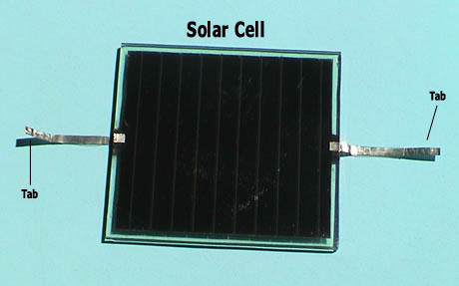
Types of Solar Cells
Amorphous Silicon Solar Cells
5 V
Affordable
Easy to wire

Slide 6
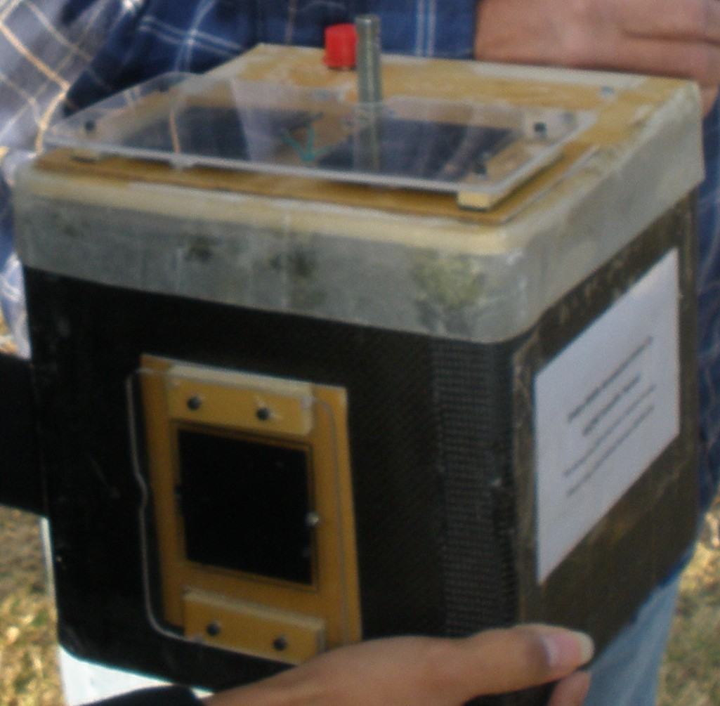
Mounting
2 on lid of payload
1 on side of payload
Plexiglas used for protection.

Slide 7
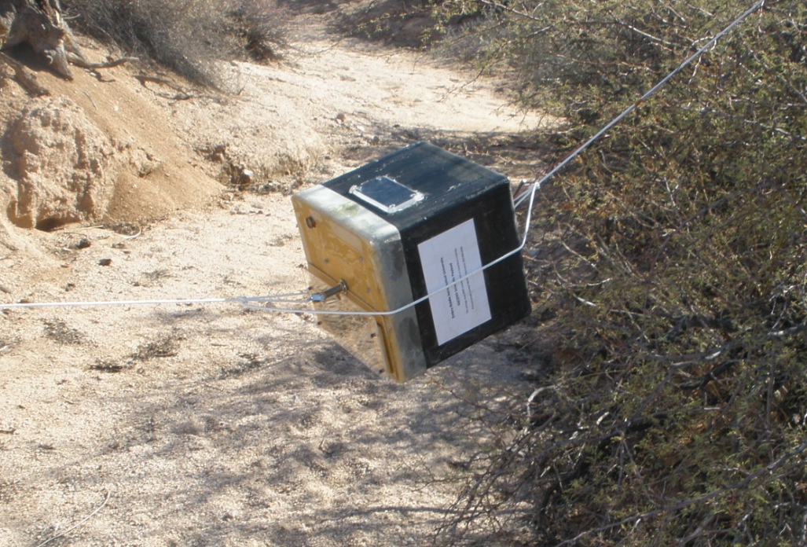
Flight Results
First launch was on November 27, 2009 in Gila Bend, AZ recovered South of Phoenix
Successful Flight – No damage

Slide 8
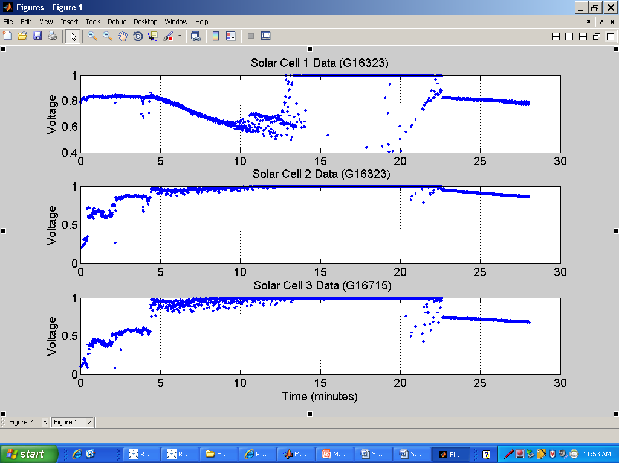
Flight Results
Peaked at 1 Volt instead of 5 Volts.
Solar Cell 1: Mounted on side.
Solar Cell 2 & 3: Mounted on lid.

Slide 9
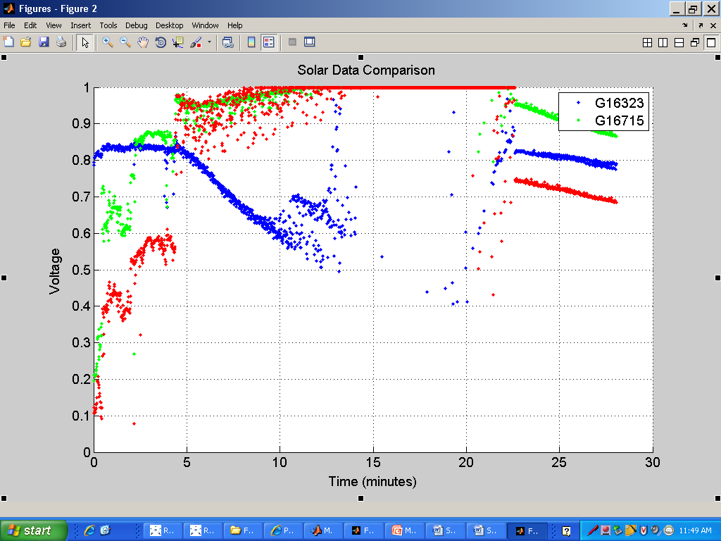
Flight Results
Combined data of the three solar cells.
Red and Green indicates top solar cells.
Blue indicates side solar cell.
Peak at 1 volt.

Slide 10
Future Goals
Add a resistor to drop down voltage readings.
Complete another flight with modified solar cells.
Obtain better results.

Slide 11

Acknowledgements
Dr. Ronald Madler
Jack Crabtree
Arizona NASA Space Grant and partners
Any Questions…

